Slide 1
Lecture_01

Slide 2
No. 1

Slide 3

PROBABILITY
Introduction to Probability

Slide 4
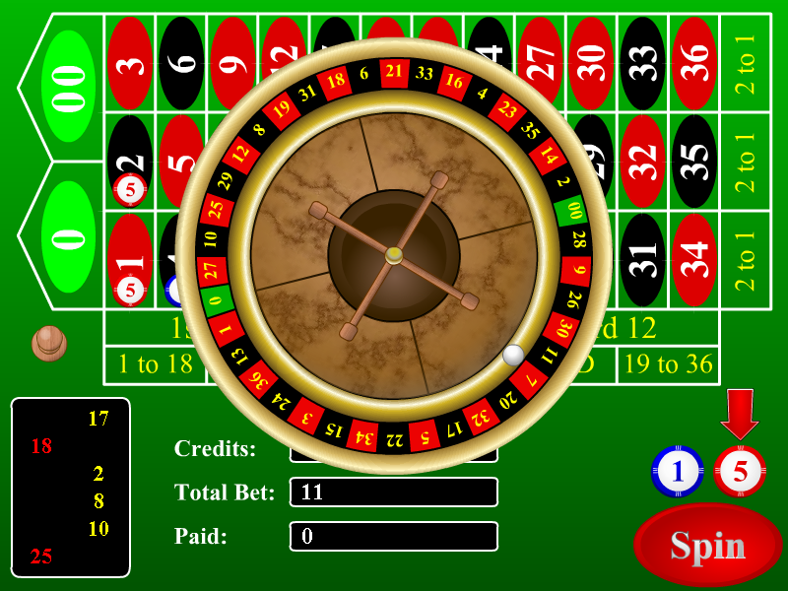

Slide 5
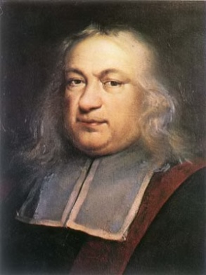
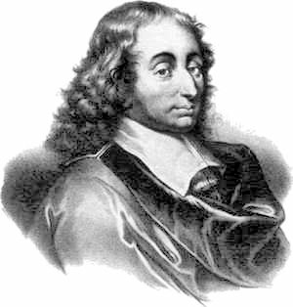
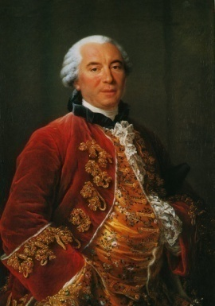
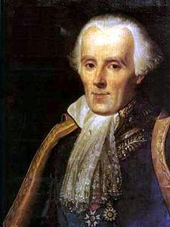
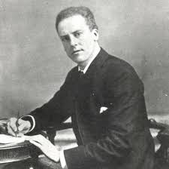
PIERRE DE FERMAT
(1601 - 1665)
BLAISE PASCAL
(1623 - 1662)
BUFFON
(1707 - 1788)
PIERRE SIMON LAPLACE (1749 - 1827)
KARL PEARSON
(1857 - 1936)

Slide 6
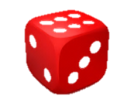
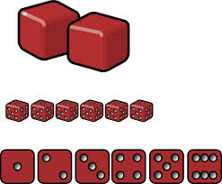
Random Experiment :
It is an experiment in which all the possible
results are known in advance but they cannot be predicted with certainty.
For eg : Rolling of a Die
What is a random experiment ?
1,
2,
3,
4,
5,
6
Possible Results
What is an outcome ?
The result of a random experiment.
Outcome
Number of all possible outcomes = 6
Here, we assume that each outcome is likely to occur equally as other.
Hence,
1,
2,
3,
4,
5,
6
Equally Likely Outcomes

Slide 7
No. 2

Slide 8
PROBABILITY
All possible outcomes of Tossing coin
experiment

Slide 9
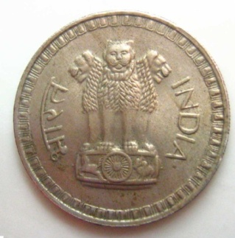
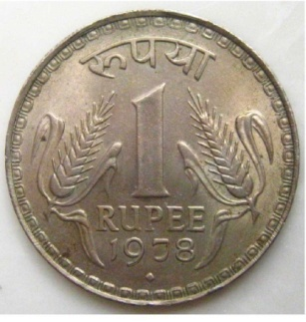

A Coin is Tossed
H
T
All possible outcomes are H, T
Number of all possible outcomes = 2

Slide 10
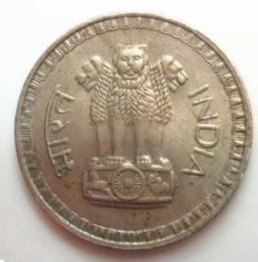

2 Coins are Tossed
Together
Result on first coin
Result of both experiments are same
Result on second coin
Result on first coin
Result on second coin
1 Coin is tossed twice
Result on first coin
HH, HT, TH, TT
Result on first coin
Result on second coin
Result on second coin
Number of all possible outcomes = 4

Slide 11

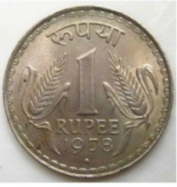

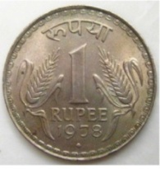



Result on
Result on
Result on
3 Coins are Tossed Together / 1 Coin is tossed thrice
1st coin/
1st time
2nd coin/
2nd time
3rd coin/
3rd time
1st coin/
1st time
2nd coin/
2nd time
3rd coin/
3rd time
Shift the position of T
One more time
So in all we have 8 outcomes
Start with HHH
Introduce T inthe end
Shift the position of T
Similarly if we start with TTT and shift the position of H we will get 4 more outcomes
Number of all possible outcomes = 8
RULE TO WRITE POSSIBLE OUTCOMES
* Write possible outcomes of 2 coins 2 times
* In first time put H as result of 3rd coin
* In second time put T as result of 3rd coin
HH , HT , TH , TT ,
H
H
H
H
T
T
HH , HT , TH , TT
T
T

Slide 12
No. 3

Slide 13
PROBABILITY
All possible outcomes of throwing 2 dice, Game of chance and Playing Cards

Slide 14
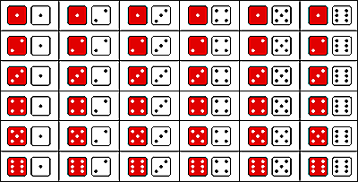
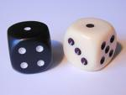
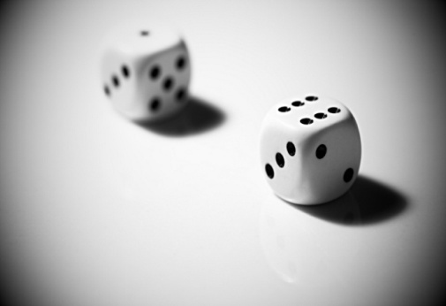
When Two Dice are Thrown together
Similarly on 1st die 2 & on 2nd die it may be 1/2/3/4/5/6
Similarly on 1st die 5 & on 2nd die it may be 1/2/3/4/5/6
Similarly on 1st die 3 & on 2nd die it may be 1/2/3/4/5/6
Similarly on 1st die 6 & on 2nd die it may be 1/2/3/4/5/6
Similarly on 1st die 4 & on 2nd die it may be 1/2/3/4/5/6
on 1st die 1 & on 2nd die 1
on 1st die 1 & on 2nd die 2
on 1st die 1 & on 2nd die 3
on 1st die 1 & on 2nd die 4
on 1st die 1 & on 2nd die 5
on 1st die 1 & on 2nd die 6
Consider the colour
of 1st die as red & of 2nd die as white
In this experiment the possible outcomes has to be written as seen here, that is 6 outcomes in every row
(1,1),
(1,2),
(1,3),
(1,4),
(1,5),
(1,6),
(2,1), (2,2), (2,3), (2,4), (2,5), (2,6),
(3,1), (3,2), (3,3), (3,4), (3,5), (3,6),
(4,1), (4,2), (4,3), (4,4), (4,5), (4,6),
(5,1), (5,2), (5,3), (5,4), (5,5), (5,6),
Number of all possible outcomes = 36
(6,1), (6,2), (6,3), (6,4), (6,5), (6,6)

Slide 15
For Coin and dice to know total no. of
outcomes we can remember as follows :
Outcome of 3rd coin
Outcome of 1st coin
Outcome of 2nd die
Outcome of 2nd coin
Outcome of 1st coin
Outcome of 2nd coin
Total no. of outcomes in 1 coin = 2
Total no. of outcomes in 2 coins = 2 × 2 = 4
Total no. of outcomes in 3 coins = 2 × 2 × 2 = 8
Total no. of outcomes in 1 die = 6
Total no. of outcomes in 2 dice = 6 × 6 = 36
Outcome of 1st die

Slide 16

Game Of Chance :
8
1
7
2
6
3
5
4
On whichever number the arrow points that number is taken as an outcome of that experiment.
All possible outcomes are 1, 2, 3, 4, 5, 6, 7, 8
Number of all possible outcomes = 8

Slide 17
No. 4

Slide 18
PROBABILITY
Playing Card Video
Event and finding probability of
an Event

Slide 19
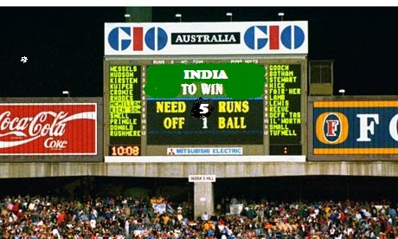
- Set of Favourable outcomes.
Event
Something that you wish should happen / should not happen
For example:
Let us assume a situation we are watching an India v/s Australia match. And 1 ball is remaining and 5 runs are required to win.
So what do we wish should happen ?
Either India should hit a six and win the match
All possible Outcomes are – {Win , Lose ,Draw}
AUSTRALIA
Any of these 3 could happen
Events are denoted by Capital Letters
Let A be the event that INDIA wins
A = { Win }
OR
Let B be the event that INDIA does not lose
B = {Win , Draw}
India should hit a four and draw the match

Slide 20
PROBABILITY OF AN EVENT
Number of outcomes favourable to E
P(E) =
Number of all possible outcomes of the experiment
An event is denoted by capital letter.
Bracket stands for of
P stands for probability

Slide 21
No. 5

Slide 22
PROBABILITY
Different types of events

Slide 23
Types of Events
Rolling of a Die
All possible outcomes 1, 2, 3, 4, 5, 6
E is the event that a number less than 7 comes up
Favorable outcomes to E
1, 2, 3, 4, 5, 6
Number less than 7 means 1, 2, 3, 4, 5, 6 …
All possible outcomes are present in an event, such an event is called SURE OR CERTAIN EVENT
P(E) =
= 1
Probability of Sure Or Certain Event = 1

Slide 24







Types of Events
Rolling of a Die
All possible outcomes 1, 2, 3, 4, 5, 6
Sum of all probabilities
= $\frac{1}{6}$ + $\frac{1}{6}$ + $\frac{1}{6}$ + $\frac{1}{6}$ + $\frac{1}{6}$ + $\frac{1}{6}$
= $\frac{6}{6}$
= 1
A is an event of getting 1
∴ P(A) = $\frac{1}{6}$
B is an event of getting 2
∴ P(B) = $\frac{1}{6}$
C is an event of getting 3
∴ P(C) = $\frac{1}{6}$
D is an event of getting 4
∴ P(D) = $\frac{1}{6}$
E is an event of getting 5
∴ P(E) = $\frac{1}{6}$
F is an event of getting 6
∴ P(F) = $\frac{1}{6}$
F is the event of getting multiple of 4
Favourable outcomes to F
4
Multiple of 4 means
4, 8, 12 ……….
Only one outcome is present in an event such an event is called ELEMENTARY EVENT
P(F) =
Sum of Probabilities of all Elementary events of an experiment = 1

Slide 25
Types of Events
Rolling of a Die
All possible outcomes 1, 2, 3, 4, 5, 6
G is the event of getting number greater than 8
No of Favourable outcomes to G
Number greater than 8 means 9, 10, 11 ……
No outcome is favourable to an event such an event is called IMPOSSIBLE EVENT
P(G) =
= 0
Probability of Impossible event = 0

Slide 26
Types of Events
Rolling of a Die
All possible outcomes 1, 2, 3, 4, 5, 6
Odd numbers are favourable
What is favourable to X ?
X is the event of getting odd number
Favourable outcomes to X
1, 3, 5
Y is the event of getting even number
Favourable outcomes to Y
2, 4, 6
Outcomes of X & Y are not same and together their outcomes gives all possible outcomes of the experiment
Hence, X & Y are said to be Complementary events
P(X) =
P(X) + P (Y) =
= 1
P(Y) =
i.e. P (X) + P (not X) = 1
Sum of Probabilities of Complementary events is equal to 1.

Slide 27
NOTE :
Probability of impossible event = 0
Probability of certain event = 1
Probability of any event lies between 0 and 1
Probability of any event cannot be negative
or it cannot be greater than 1

Slide 28
EXERCISE 15.1 Q.1,2,4,5
No. 6

Slide 29
PROBABILITY
Objective Questions based on different types of events & Equally likely Outcomes

Slide 30
Q. Complete the following statements.
(i) Probability of an event E + Probability of the event ‘not E’ = ____.
(ii) The probability of an event that cannot happen is ______. Such an event is called __________________.
The probability of an event that is certain to happen is ____. Such an event is called _____________________.
The sum of the probabilities of all the elementary
events of an experiment is _____.
The probability of an event is greater than or
equal to ____ and less than or equal to ___
1
0
Impossible event
1
sure / certain event
1
0
1

Slide 31
Q. Which of the following experiments have equally likely
outcomes? Explain
(i) A driver attempts to start a car. The car starts or does not start.
A player attempts to shoot a basketball. She/he shoots or
misses the shot.
(iii) A trial is made to answer a true-false question. The answer is right or wrong.
(iv) A baby is born. It is a boy or a girl.
Sol. (iii) and (iv) have equally likely outcomes.
To say for an incomplete statement whether it has equally likely outcomes is not possible
Because we don’t know anything about the car or the driver
This experiment does not have equally likely outcomes
This experiment does not have equally likely outcomes
Answer to any true or false question is either right or wrong
This experiment has equally likely outcomes
Whenever a baby is born it is either a boy or a girl
This experiment has equally likely outcomes
Because we don’t know the ability of the player
This statement is not complete
This statement is incomplete

Slide 32
Q. Which of the following cannot be the probability of an event?
(A)
(B) – 1.5 (C) 15% (D) 0.7
We know one relation between probability of E and probability of not E.
We have just learnt probability of any event lies between 0 and 1
Probability of an event can never be negative
Sol.
It cannot be less than 0 or it cannot be more than 1
(B) – 1.5
4. If P(E) = 0.05, what is the probability of ‘not E’ ?
Sol.
P(E) = 0.05
= 1
= 1 – P (E)
= 1 – 0.05
= 0.95
∴
∴ The probability of not E is 0.95

Slide 33
Thank You

